Slide 1

Module 1
Regression Basics
Notes:
Guidelines
Use section headers to chunk content in your presentation.
Use the same style of section header throughout your presentation.
Keep your title to no more than 2 lines.

Slide 2
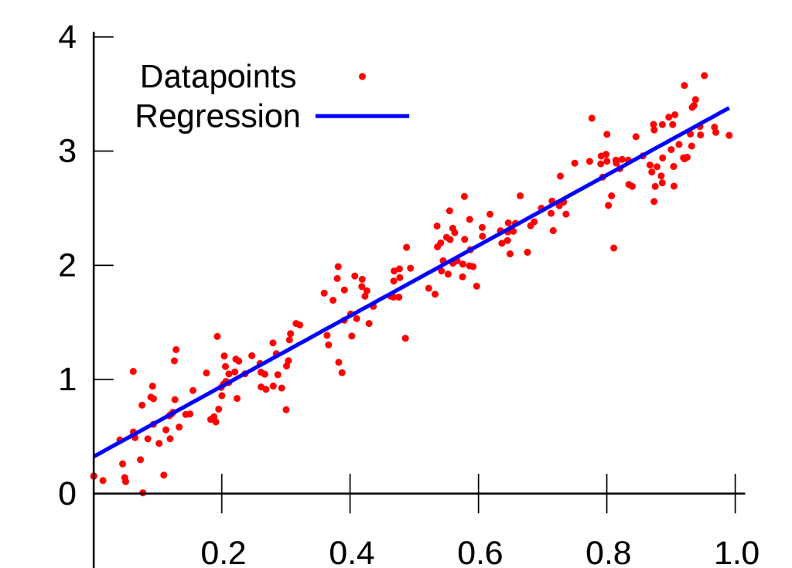
Simple Linear Regression
Notes:
Guidelines
Use a title slide at the beginning of your presentation. There are 9 variations of title slides to choose from.
If you will have a series of slideshows, we recommend using the same style of title slide for each presentation.
Keep your title to no more than 2 lines.
Do not change the font style or font size of the title or subtitle.

Slide 3
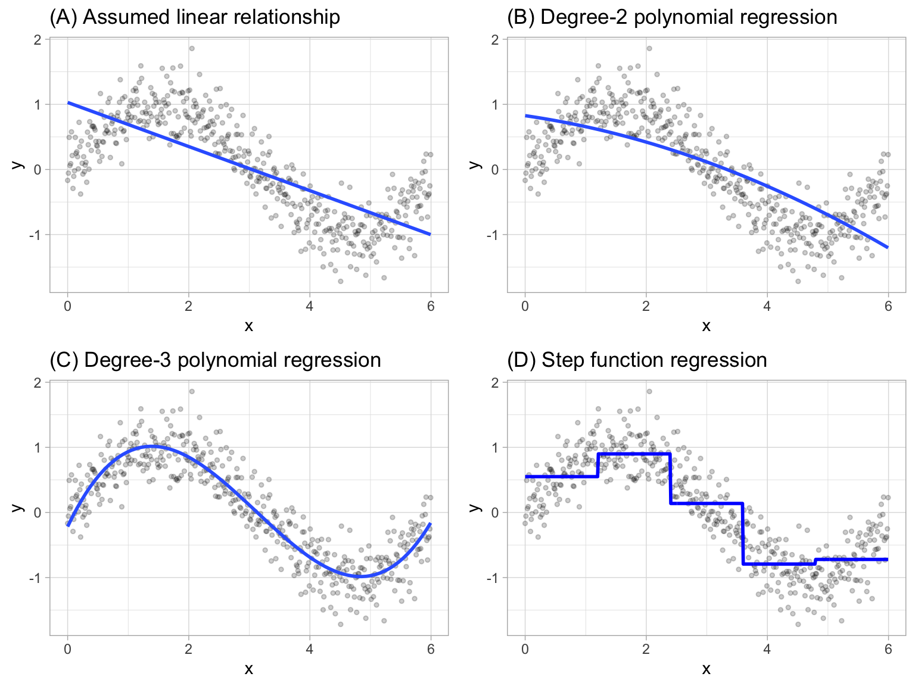
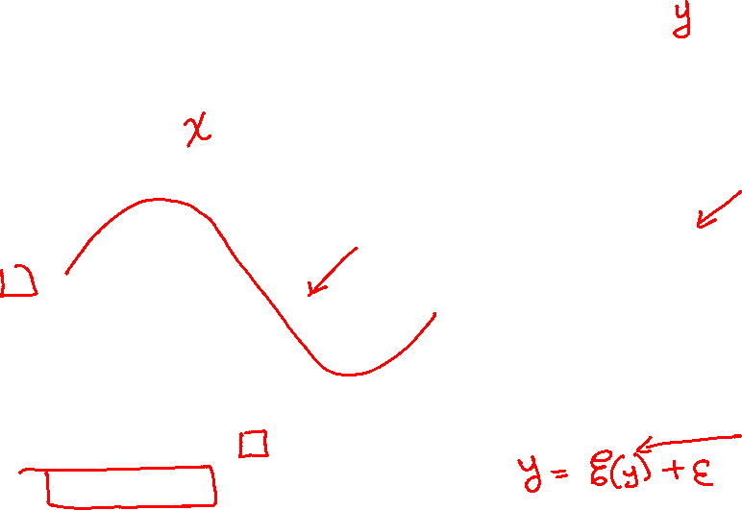
Regression
Estimates the relationship between a dependent variable (numeric) and one or more independent variables.
$y=E\left(y\right)+ε$

Slide 4

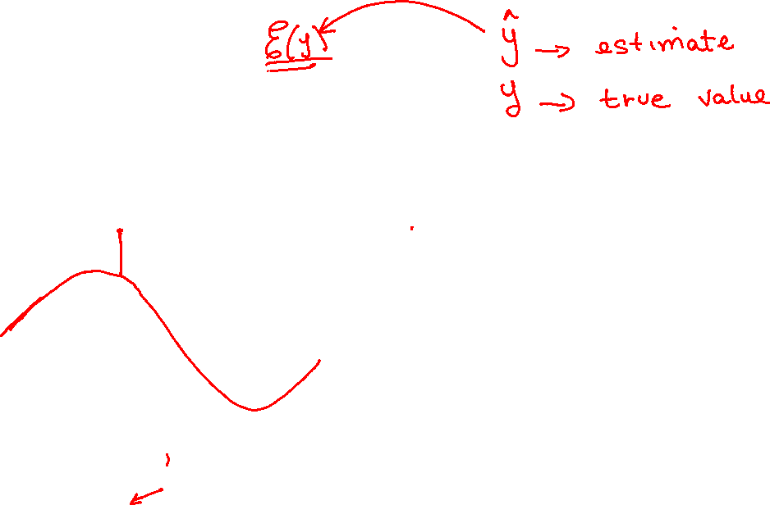
Regression
How we estimate $E\left(y\right)$ determines the model
The estimate of $E\left(y\right)$ can be linear or linear. We call it $\hat{y}$
$y=E\left(y\right)+ε$

Slide 5

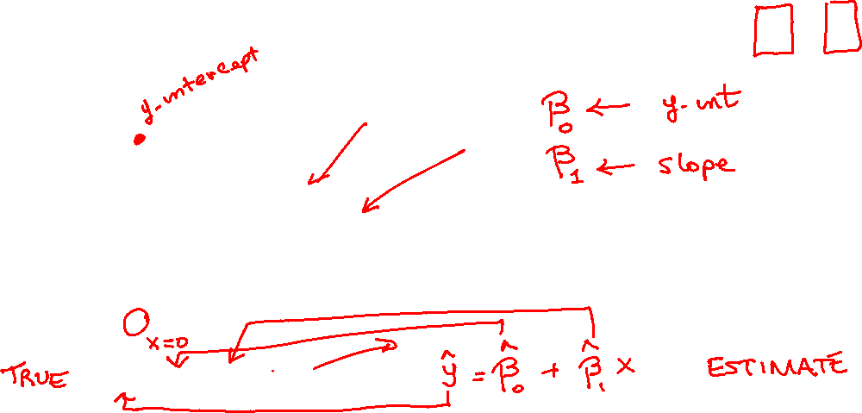
Linear Regression
We use a line (or linear plane) to estimate $E\left(y\right)$
We assume that $E\left(y\right)$ is linear. That is ${E\left(y\right)=β}_{0}+β_{1}x$
$y=β_{0}+β_{1}x+ε$

Slide 6




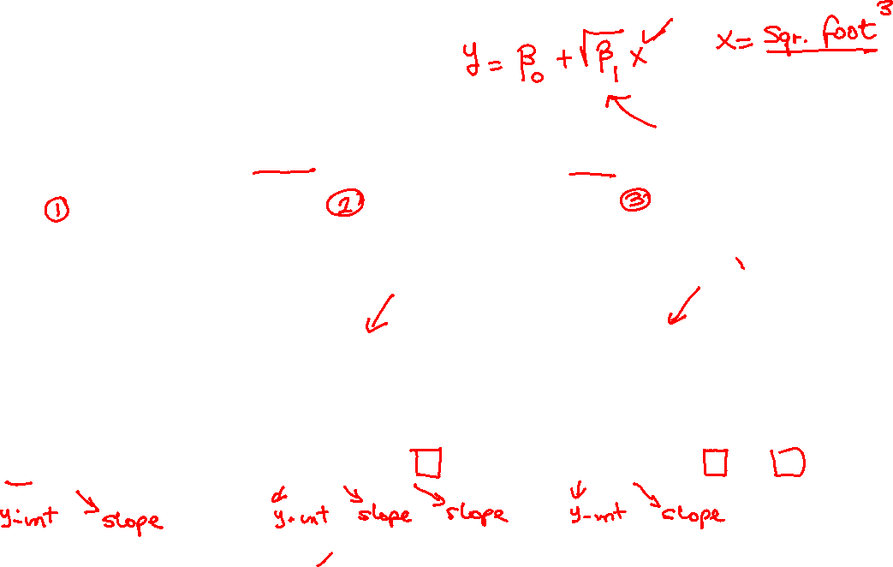
Linear Regression
Equation must be linear in the parameters $β_{i}$
$y=β_{0}+β_{1}x+ε$
$y=β_{0}+β_{1}x+β_{2}x^{2}+ε$
$y=β_{0}+β_{1}x+β_{2}x^{2}+β_{3}x^{3}+ε$

Slide 7

Linear Regression Uses
Finance: a commonly used measure for stock performance is a “Beta” of a stock
Accounting: Studying how changing between FILO vs LIFO practices effect firm value
Supply Chain: Forecasting demand over a time period
Marketing: Predicting customer value using demographic data and purchasing habits
Information Systems: Predicting a project budget based on past project information.
Management: CEO Compensation
Economics: Regression is everything.

Slide 8
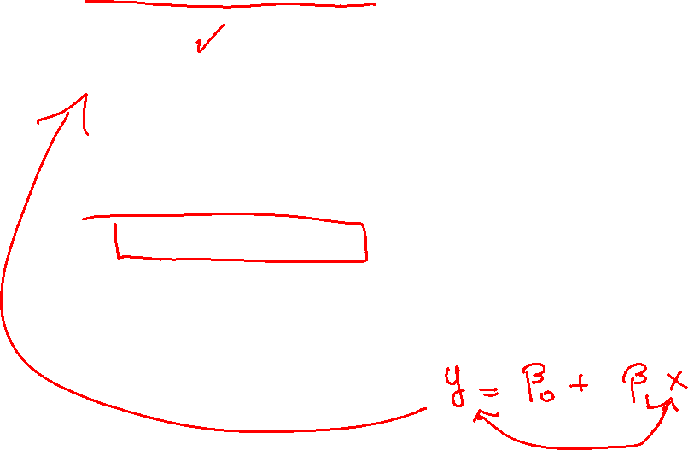
Observational vs Experimental Data
Observational Data: : if the values of the independent variables, x′s, in a regression are uncontrolled (meaning not set in advance before observing y) but are measured without error, the data are observational
Experimental Data: If the values of the independent variables, x′s, in a regression are controlled using a designed experiment (i.e. set in advance before the value of y is observed), the data are experimental.

Slide 9


Which of the following models are linear?
ⓘ Start presenting to display the poll results on this slide.

Slide 10
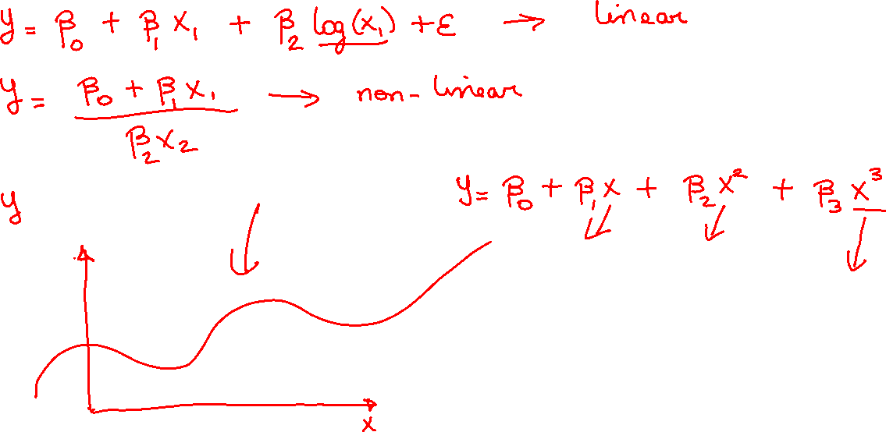

Slide 11
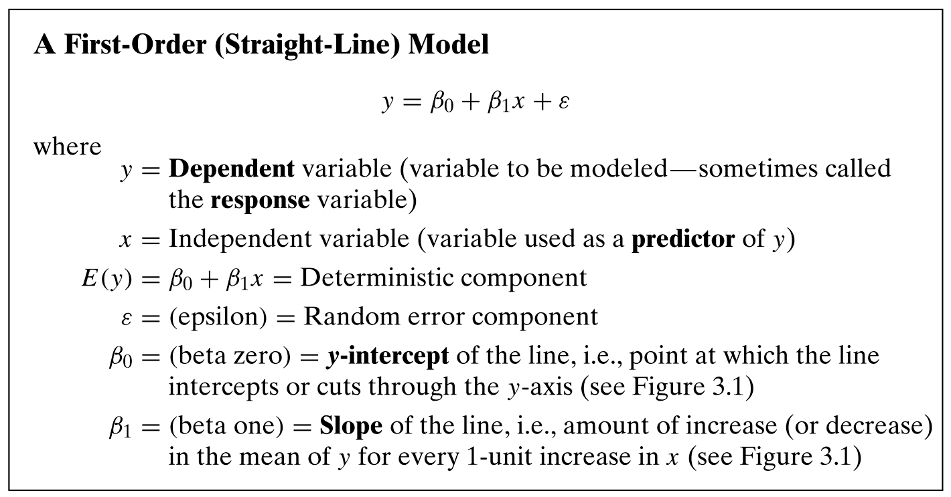
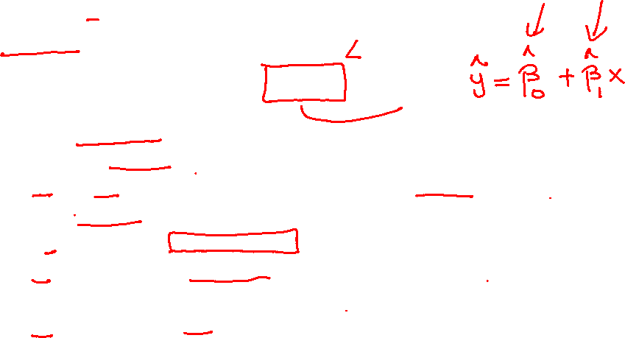
The First-Order Model

Slide 12
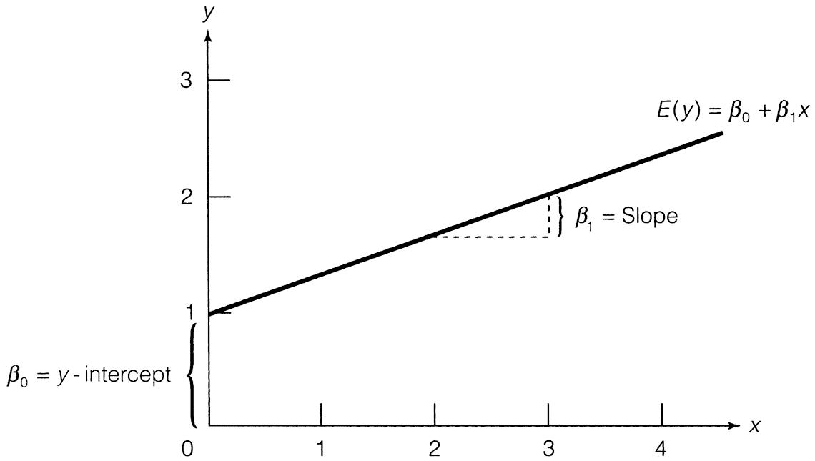


Fitting a Model
Means obtaining estimates to the parameters of the model $β_{i}$
$y=β_{0}+β_{1}x+ε$

Slide 13
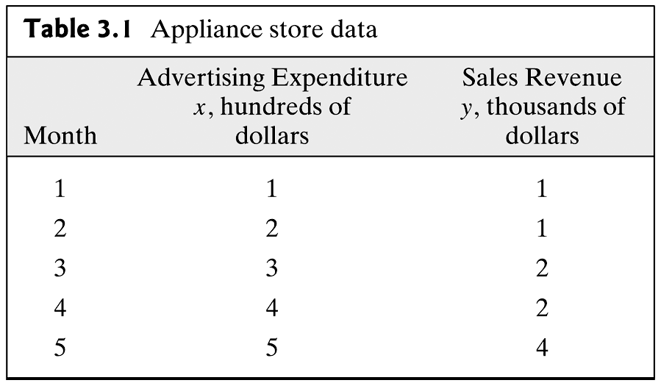
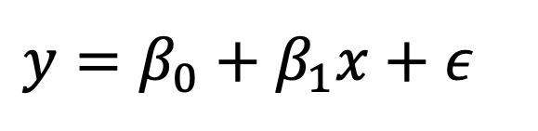
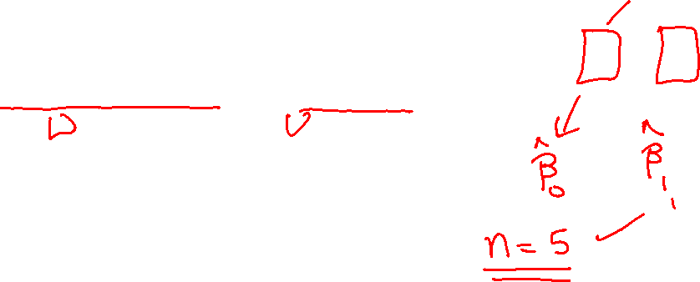
Fitting a Model
Example of Model Fitting
$y=β_{0}+β_{1}x+ε$

Slide 14
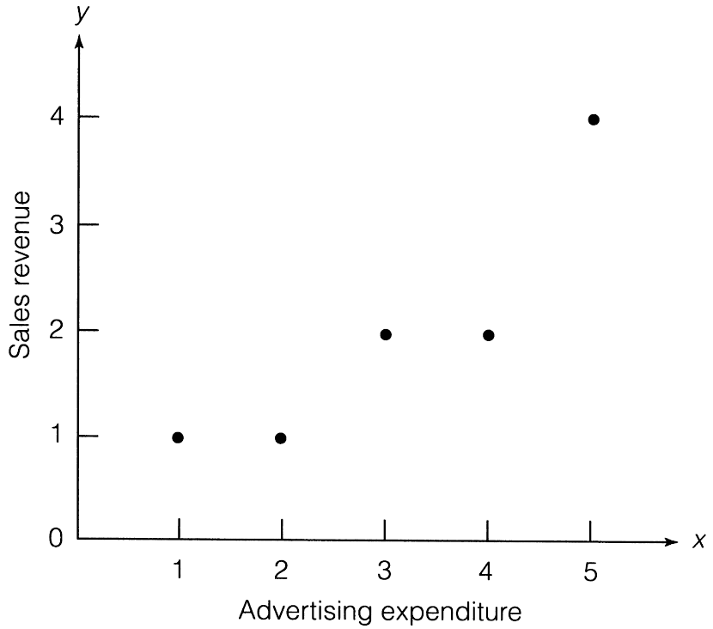
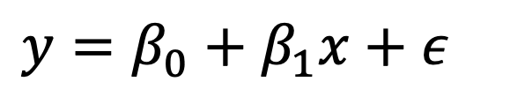
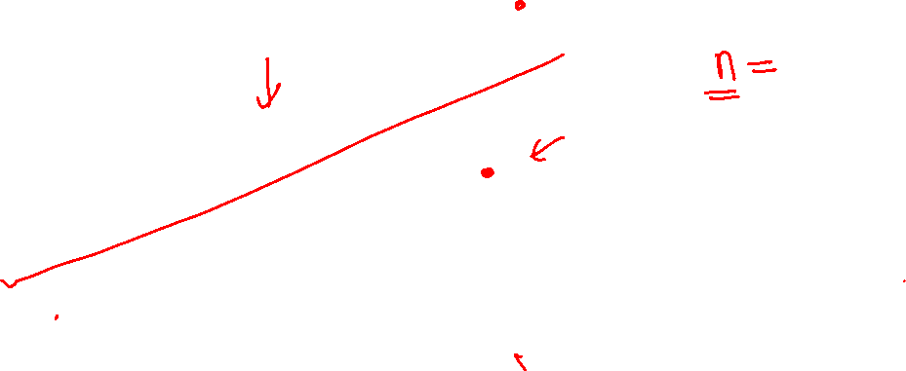
Fitting a Model
We generally check for adequacy of fitting a linear model
$y=β_{0}+β_{1}x+ε$

Slide 15


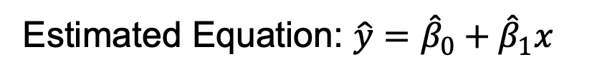
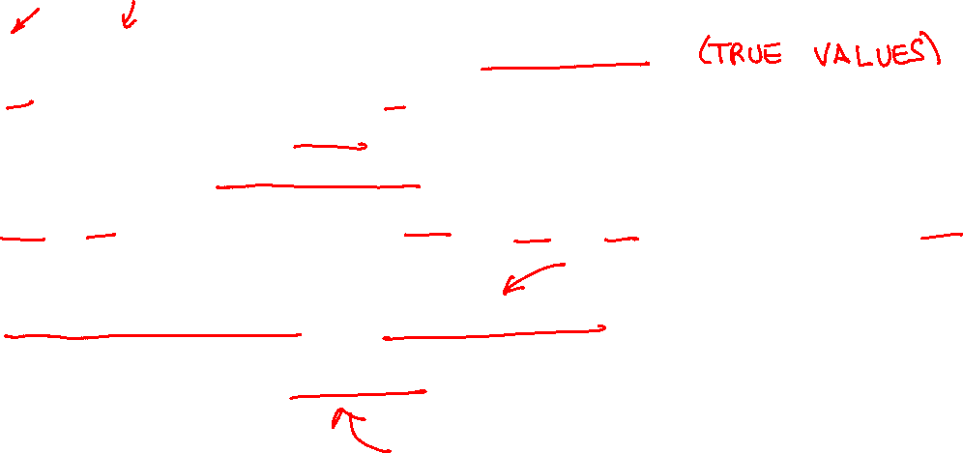
Terminology
β₀ and β₁ are called regression parameters
β₀ is the y-intercept and β₁ is the slope
We do not know the true values of these parameters
We must use sample data to estimate them
${\hat{β}}_{0}$or b₀ is the estimate of β₀ and ${\hat{β}}_{1}$ or b₁ is the estimate of β₁
True Regression Equation: $y=β_{0}+β_{1}x+ε$
Estimated Equation: $\hat{y}={\hat{β}}_{0}+{\hat{β}}_{1}x$

Slide 16
The dependent variable is also called a predictor variable
ⓘ Start presenting to display the poll results on this slide.

Slide 17
The true mean or expected value of y is denoted as
ⓘ Start presenting to display the poll results on this slide.

Slide 18
epsilon is called the random error component.
ⓘ Start presenting to display the poll results on this slide.

Slide 19
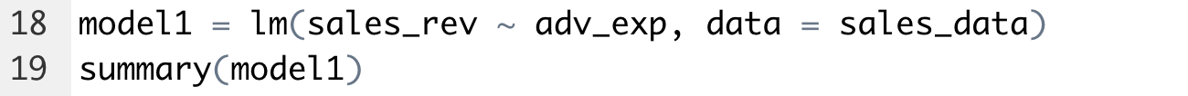

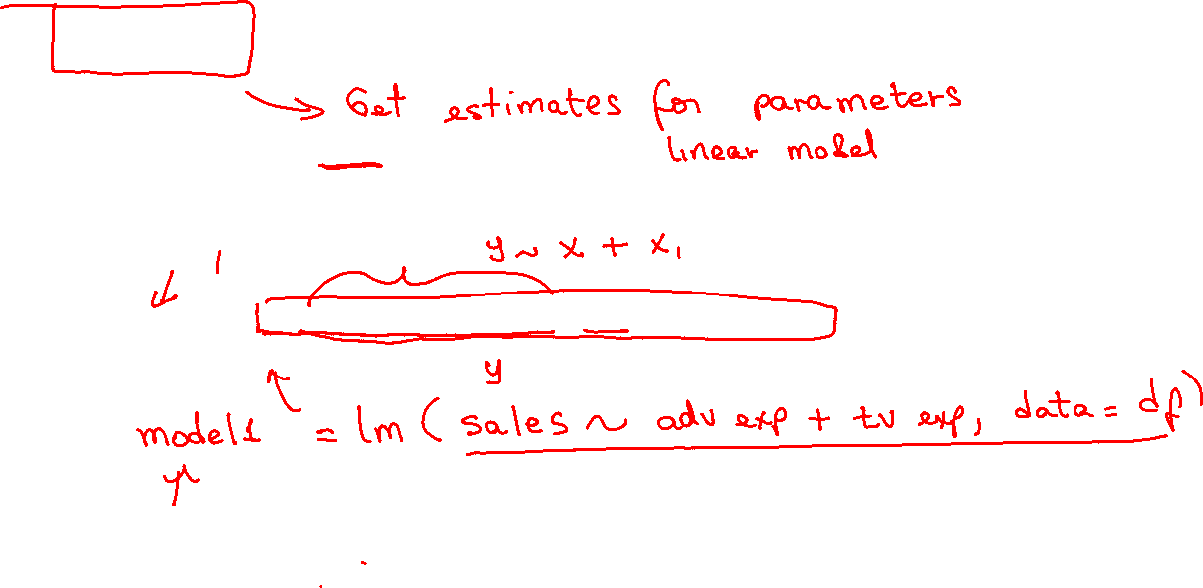
Fitting a Linear Regression Model in R
We use the lm()function
lm() stands for linear model
Syntax is given below:

Slide 20

Practice

Slide 21
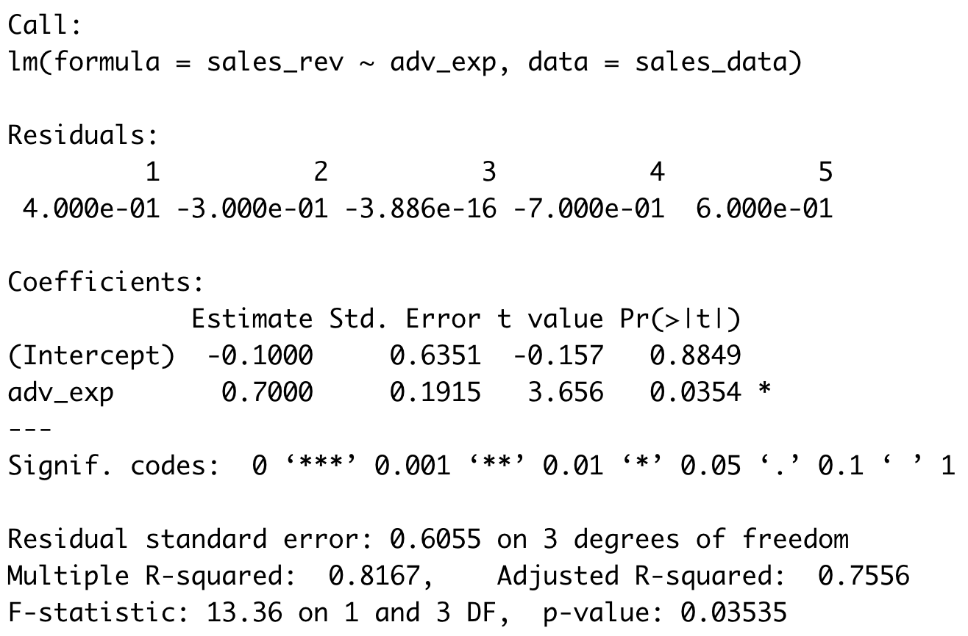


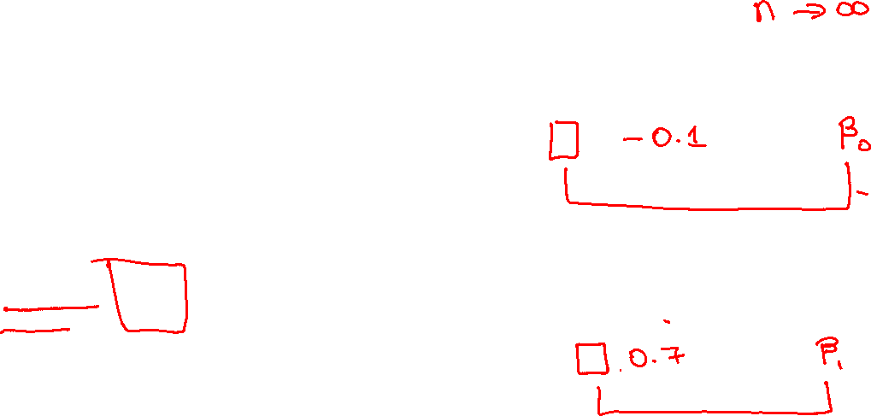
(Least-Squares) Estimates
The summary()function shows the estimates
$${\hat{β}}_{0}$$
$${\hat{β}}_{1}$$

Slide 22
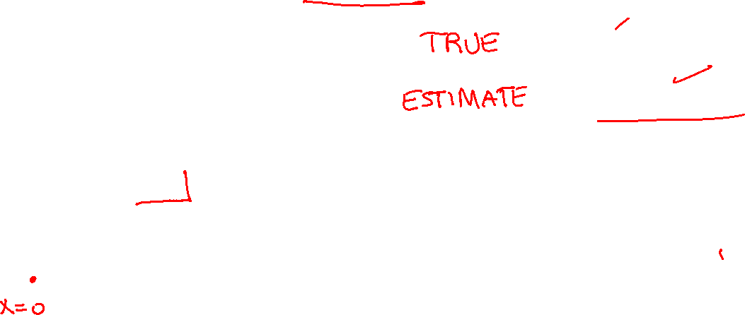
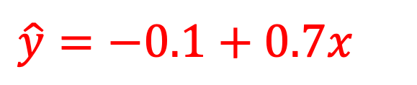
Fitting a Model
The estimates are the “best guesses” of the parameters
$y=β_{0}+β_{1}x+ε$
$$\hat{y}=−0.1+0.7x$$

Slide 23
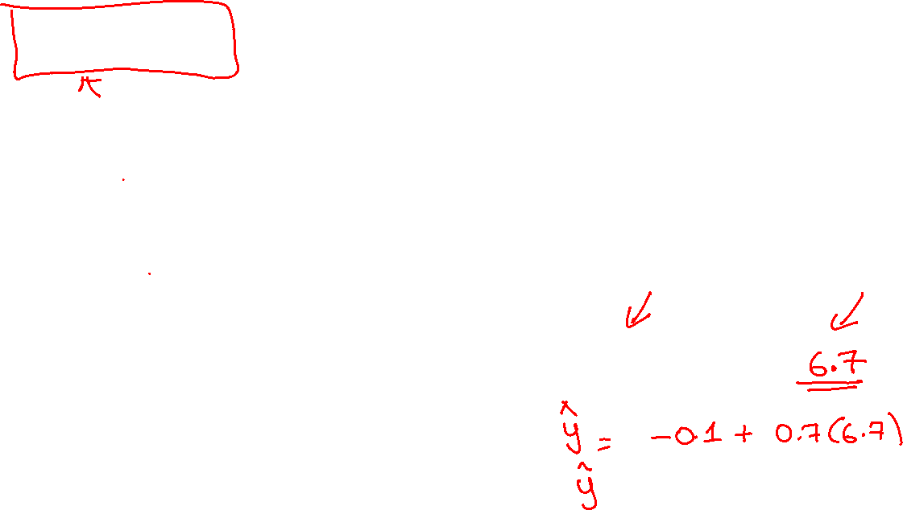

Predicted Values
Are estimates of $y$ for given value of $x$
$y=β_{0}+β_{1}x+ε$
$$\hat{y}=−0.1+0.7x$$

Slide 24
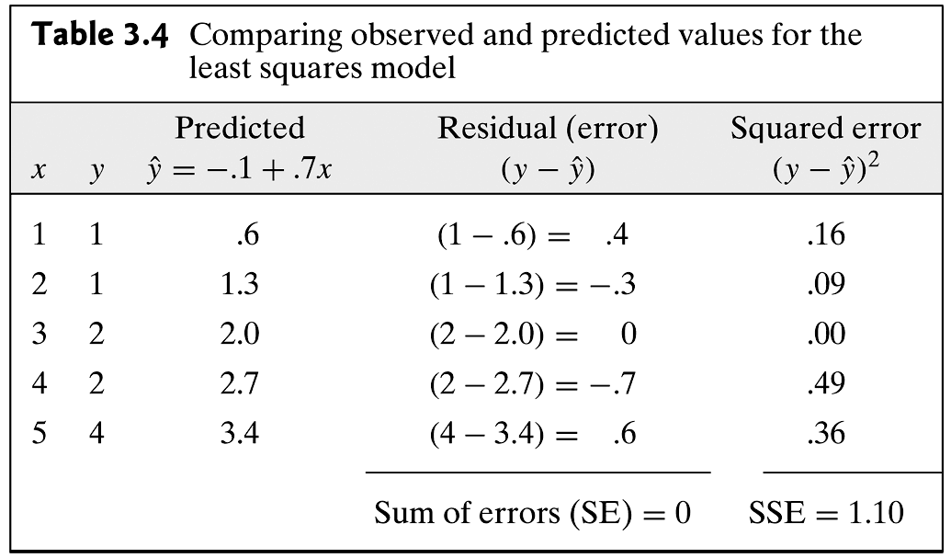
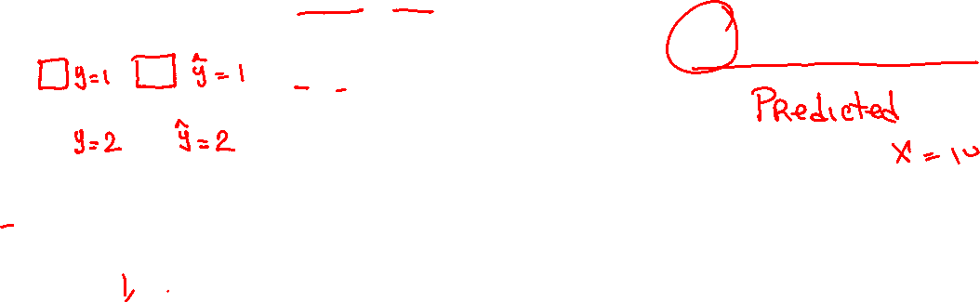
Predicted Values
Are estimates of $y$ for given value of $x$
$y=β_{0}+β_{1}x+ε$
$$\hat{y}=−0.1+0.7x$$

Slide 25
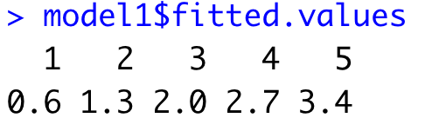

Predicted Values
Are estimates of $y$ for given value of $x$
$y=β_{0}+β_{1}x+ε$
$$\hat{y}=−0.1+0.7x$$

Slide 26
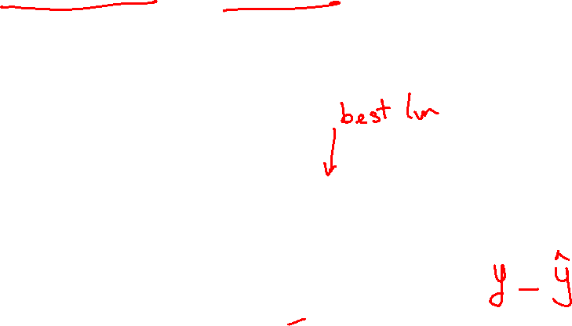

Residual (Errors)
Differences between true (actual) $y$ and predicted $\hat{y}$
$y=β_{0}+β_{1}x+ε$
$$\hat{y}=−0.1+0.7x$$

Slide 27

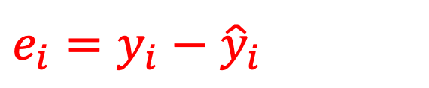
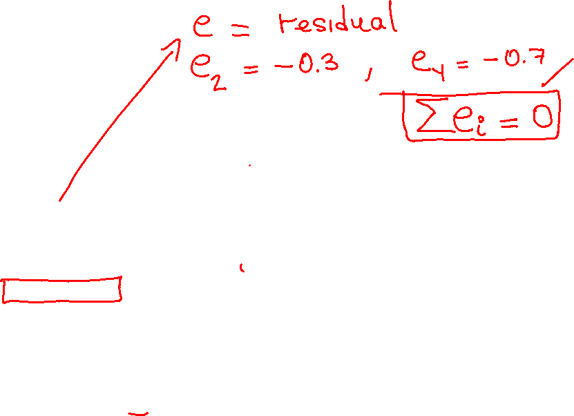
Residual (Errors)
Differences between true (actual) $y$ and predicted $\hat{y}$
$y=β_{0}+β_{1}x+ε$
$$\hat{y}=−0.1+0.7x$$
Residuals
$$e_{i}=y_{i}−{\hat{y}}_{i}$$

Slide 28
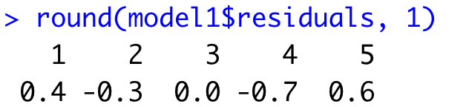
Residual (Errors)
Are estimates of $y$ for given value of $x$
$y=β_{0}+β_{1}x+ε$
$$\hat{y}=−0.1+0.7x$$

Slide 29
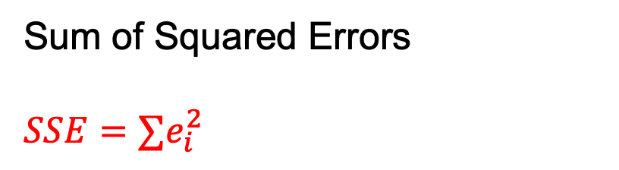
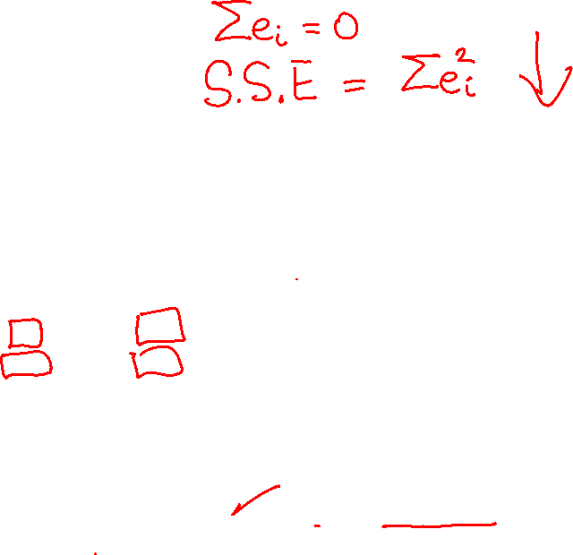
Performance Metrics
The Sum of Squared Errors (SSE) is a performance metric
$y=β_{0}+β_{1}x+ε$
$$\hat{y}=−0.1+0.7x$$
Sum of Squared Errors
$${SSE=∑e}_{i}^{2}$$
SSE is minimized in each regression

Slide 30
Practice

Slide 31
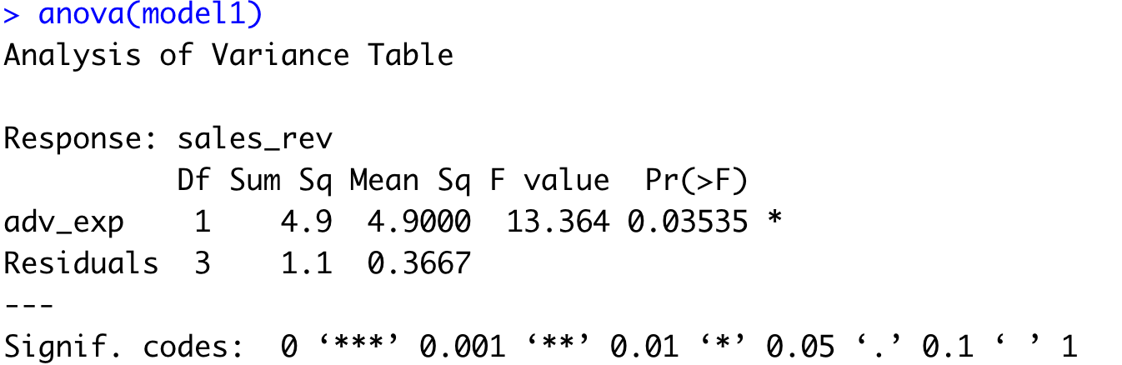
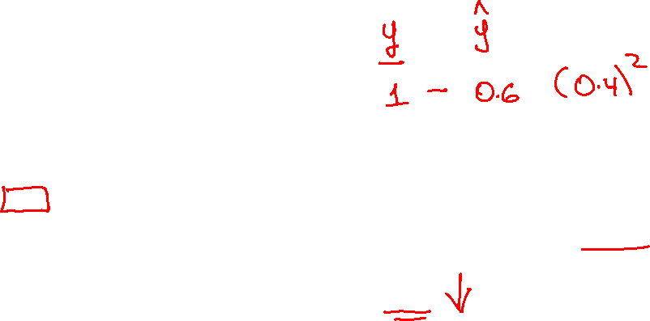
The Sum of Squared Errors
The anova()function shows the estimates
SSE

Slide 32
The distance from each actual value y to the regression line yhat is called
ⓘ Start presenting to display the poll results on this slide.

Slide 33
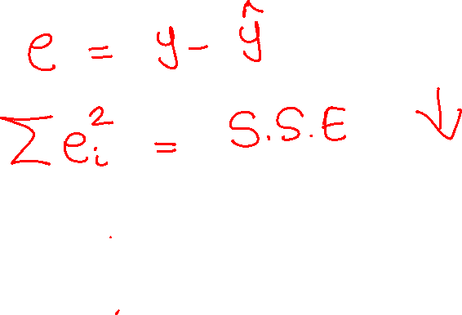

Slide 34
What statistics get(s) minimized to obtain the least-squares regression estimates?
ⓘ Start presenting to display the poll results on this slide.

Slide 35
